Slide 1




studio shodwe
FUTURE TECHNOLOGY
Exploring innovations that will shape our world tomorrow.
page 01

Slide 2
studio shodwe
Artificial Intelligence is rapidly advancing, bringing transformative changes across various industries. From healthcare to finance, AI is enhancing decision-making, automating tasks, and enabling machines to learn and adapt in ways that were previously unimaginable. This evolution is paving the way for smarter, more efficient systems that will redefine the way we live and work.
ARTIFICIAL INTELLIGENCE EVOLUTION
page 02
www.reallygreatsite.com

Slide 3

studio shodwe
QUANTUM COMPUTING
Quantum computing represents a leap forward in computational power, harnessing the principles of quantum mechanics to perform complex calculations at unprecedented speeds. Unlike classical computers, which use bits as the basic unit of information, quantum computers use qubits, allowing them to process vast amounts of data simultaneously. This breakthrough could revolutionize fields like cryptography, material science, and artificial intelligence.
page 04
www.reallygreatsite.com

Slide 4

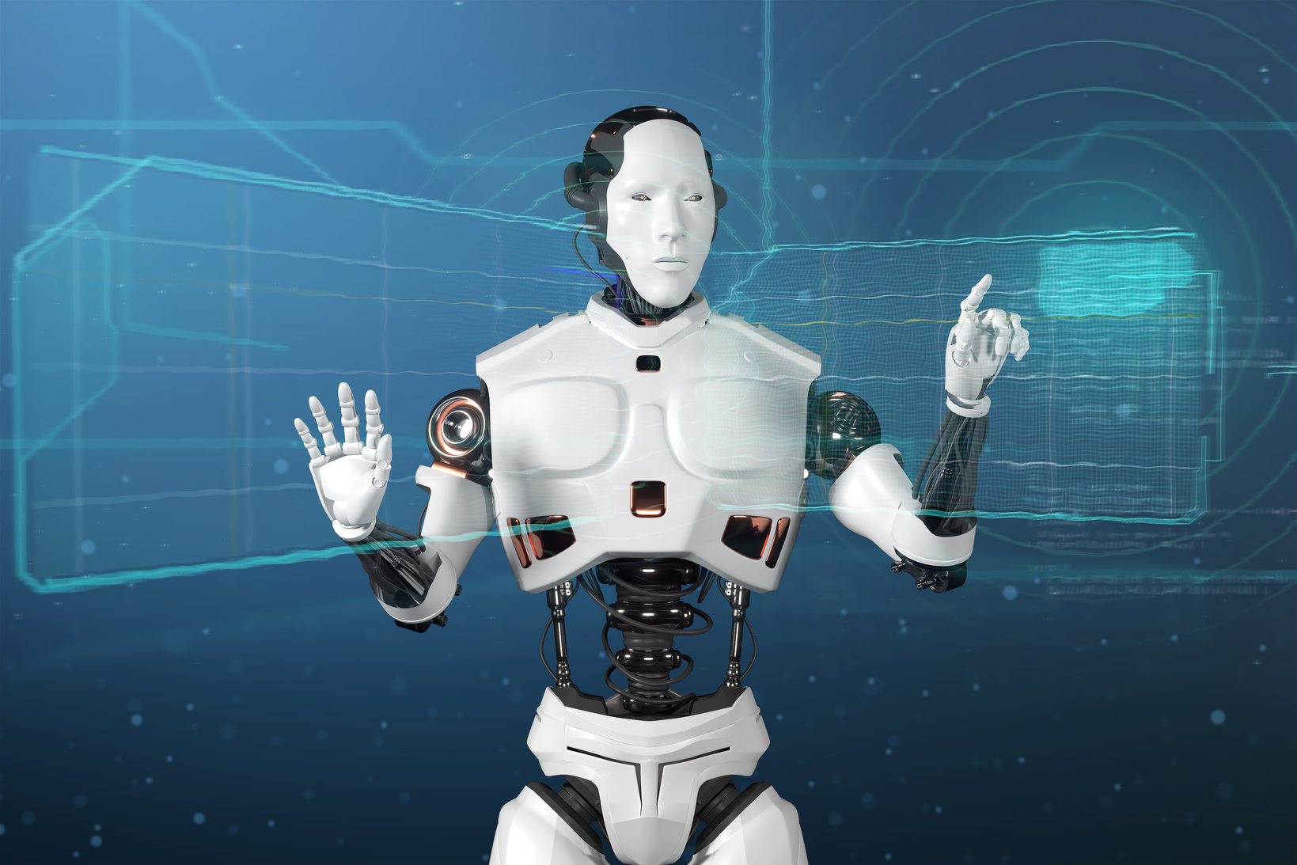
studio shodwe
5G NETWORKS
The deployment of 5G networks is revolutionizing how we connect and communicate. With significantly faster data speeds, lower latency, and the capacity to support a massive number of connected devices, 5G is enabling new applications like smart cities, autonomous vehicles, and advanced IoT (Internet of Things) solutions. This technology is laying the foundation for a more connected and efficient world.
page 02
www.reallygreatsite.com

Slide 5

studio shodwe
AUTONOMOUS VEHICLES
Autonomous vehicles, or self-driving cars, are set to transform the transportation industry. By leveraging advanced sensors, AI, and real-time data, these vehicles can navigate roads with minimal human intervention. The adoption of autonomous vehicles promises to enhance road safety, reduce traffic congestion, and provide greater mobility options, particularly for those who are unable to drive.
page 05
www.reallygreatsite.com

Slide 6


studio shodwe
SMART CITIES
1.
2.
3.
Energy Efficiency
Public Transportation
Waste Management
Optimizing energy use through smart grids and sustainable infrastructure.
Enhancing transit systems with real-time data and autonomous vehicles.
Implementing smart waste collection and recycling systems for cleaner cities.
page 06
www.reallygreatsite.com

Slide 7

studio shodwe
1.
Solar Power
Utilizing photovoltaic panels to convert sunlight into electricity, providing a clean and renewable energy source that reduces carbon emissions.
RENEWABLE ENERGY
2.
Wind Turbines
Capturing wind energy through large turbines to generate electricity, contributing to a sustainable energy mix and decreasing reliance on fossil fuels.
page 07
www.reallygreatsite.com

Slide 8
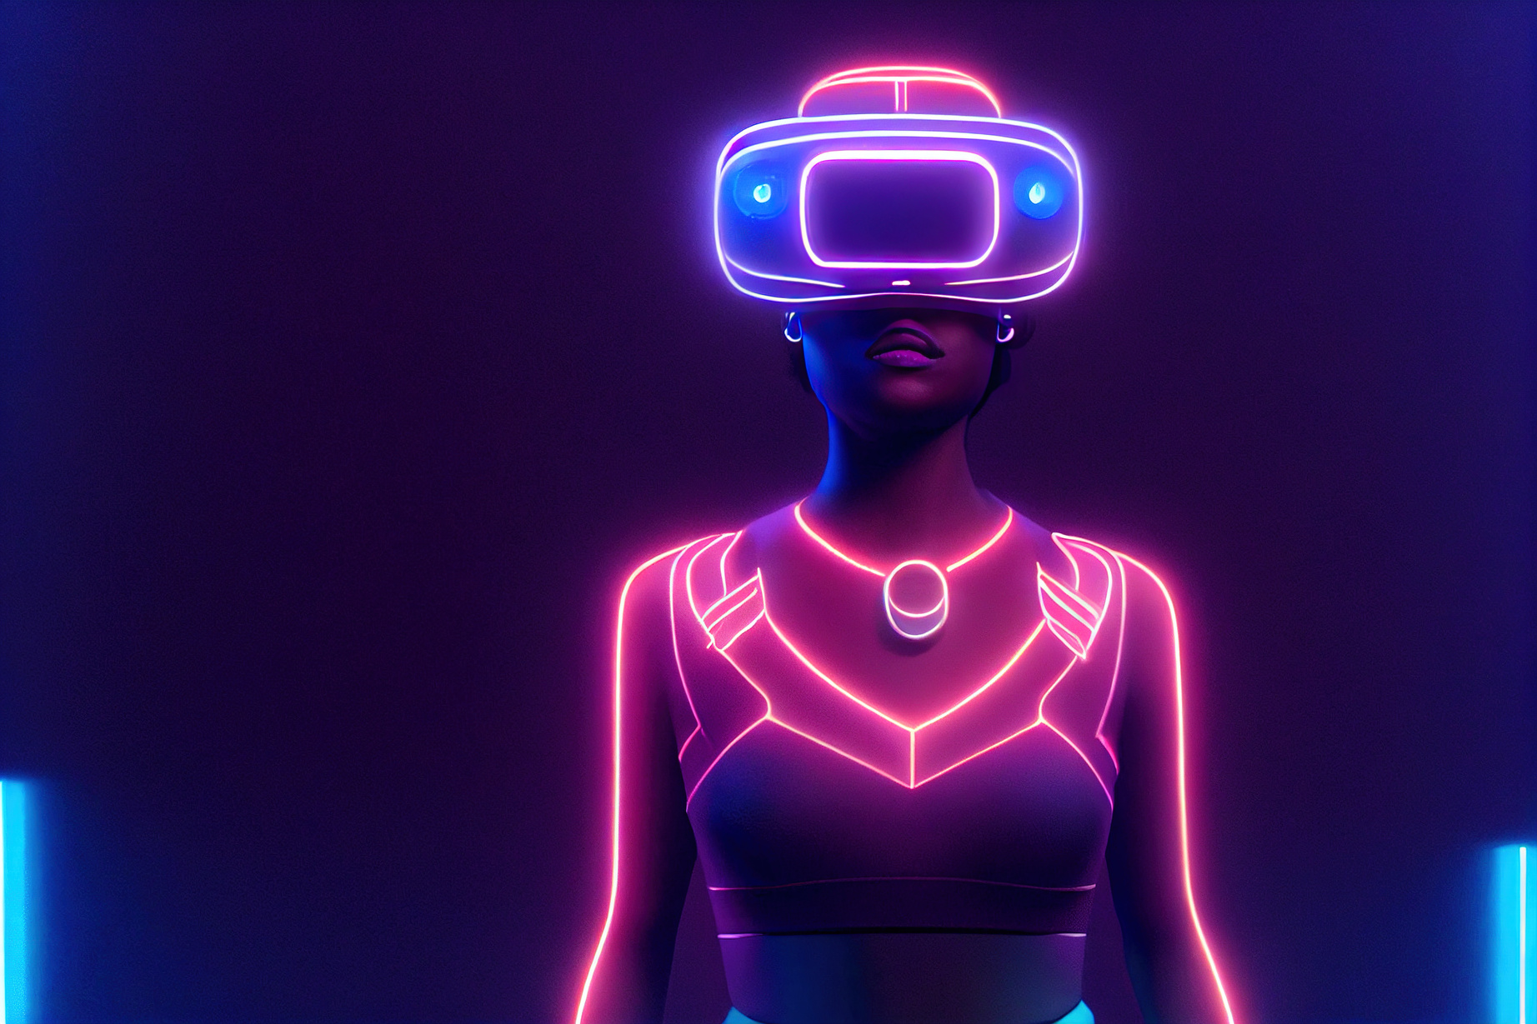

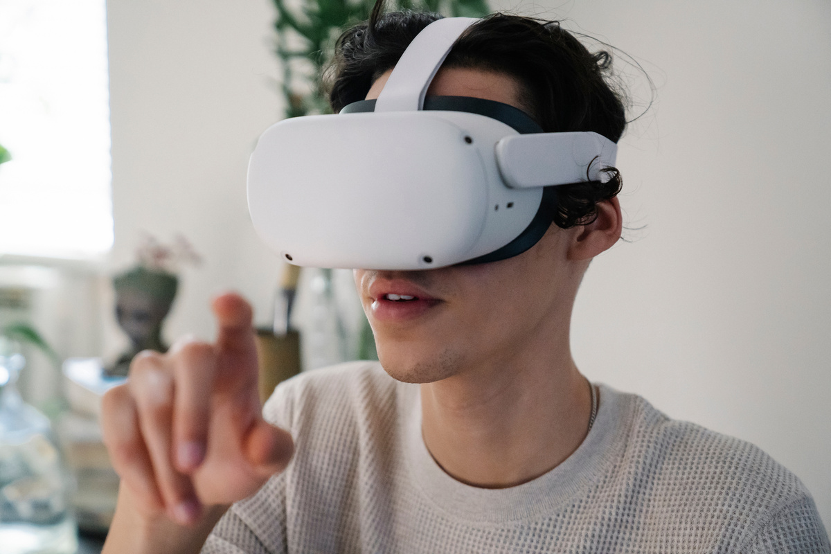
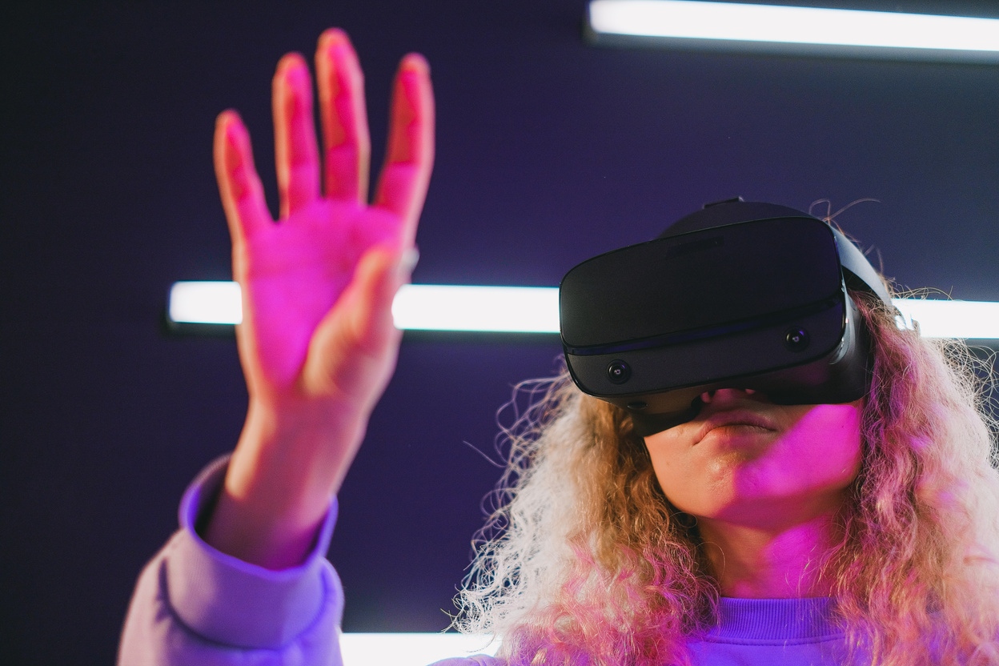
studio shodwe
VIRTUAL REALITY
Virtual Reality (VR) is extending its reach beyond gaming into areas like education, healthcare, and entertainment. By creating immersive, interactive experiences, VR has the potential to revolutionize how we learn, train, and even treat medical conditions. As the technology continues to improve, VR is expected to become an integral part of various industries, offering new ways to engage and experience the world.
page 06
www.reallygreatsite.com

Slide 9


studio shodwe
SPACE EXPLORATION
Space exploration is entering a new era, driven by advances in technology and a renewed interest in reaching beyond our planet. From ambitious missions to Mars to the development of space tourism, these efforts are expanding our understanding of the universe and pushing the boundaries of what humanity can achieve. The future of space exploration holds the promise of new discoveries and the potential for human settlement on other planets.
page 06
www.reallygreatsite.com

Slide 10
studio shodwe
THANK YOU!
As we look to the future, these technologies will play a crucial role in shaping a better world for generations to come.
page 10
www.reallygreatsite.com

